Slide 1
PRESENTATION NoSQL
Notes:
Utilisez un titre spécifique et direct. Utilisez le sous-titre pour décrire le contexte spécifique de l’argumentaire.
- L’objectif doit être de capter l’attention du public. Vous pouvez inclure une citation, une statistique surprenante ou un fait pour y parvenir. Il n’est pas nécessaire d’inclure cette information sur la diapositive.

Slide 2
What is NoSQL
Stands for Not Only SQL. Term was redefined by Eric Evans after Carlo Strozzi.
Class of non-relational data storage systems.
Do not require a fixed table schema nor do they use the concept of joins.
Relaxation for one or more of the ACID properties (Atomicity, Consistency, Isolation, Durability) using CAP theorem.
Notes:
Utilisez les points généraux pour donner des informations qui ne sont pas connues de tous ou dont le public a besoin pour comprendre le contexte de l’argumentaire.
- Ne vous contentez pas de lire les points principaux sur la diapositive. Développez plutôt ces points pendant le discours.

Slide 3
Need of NoSQL
Explosion of social media sites (Facebook, Twitter, Google etc.) with large data needs. (Shardingis a problem)
Rise of cloud-based solutions such as Amazon S3 (simple storage solution).
Just as moving to dynamically-typed languages (Ruby/Groovy), a shift to dynamically-typed data with frequent schema changes.
Expansion of Open-source community.
NoSQL solution is more acceptable to a client now than a year ago.
Notes:
Le titre du point principal 1 doit être clair et concis. Chaque argument doit être résumé dans un objectif de clarté et cité correctement. Ne vous contentez pas de lire les différents arguments, mais développez lorsque c’est nécessaire.
[Tapez des notes à développer ici]
Veillez à faire la transition entre le deuxième point principal et la diapositive suivante.

Slide 4
Characteristics of NoSQL
It’s more than rows in tables—NoSQL systems store and retrieve data from many formats: key-value stores, graph databases, column-family (Bigtable) stores, document stores, and even rows in tables.
It’s free of joins—NoSQL systems allow you to extract your data using simple interfaces without joins.
It’s schema-free—NoSQL systems allow you to drag-and-drop your data into a folder and then query it without creating an entity-relational model.
It works on many processors—NoSQL systems allow you to store your database on multiple processors and maintain high-speed performance.
It uses shared-nothing commodity computers—Most (but not all) NoSQL systems leverage low-cost commodity processors that have separate RAM and disk.
It supports linear scalability—When you add more processors, you get a consistent increase in performance.
It’s innovative—NoSQL offers options to a single way of storing, retrieving, and manipulating data. NoSQL supporters (also known as NoSQLers) have an inclusive
attitude about NoSQL and recognize SQL solutions as viable options. To the NoSQL community, NoSQL means “Not only SQL.”

Slide 5
NoSQL Types
NoSQL data base are classified into four types:
Key Value pair based
Column based
Document based
Graph based

Slide 6
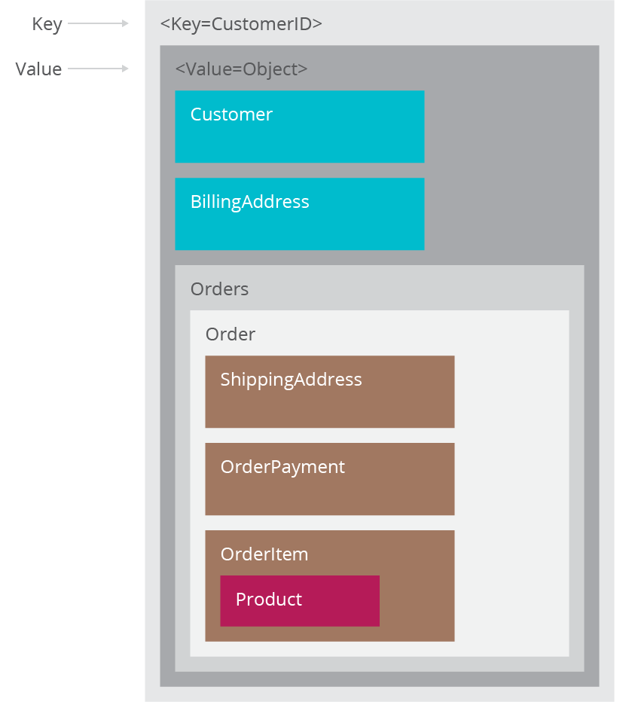
Key Value Pair Based
Designed for processing dictionary. Dictionaries contain a collection of records having fields containing data.
Records are stored and retrieved using a key that uniquely identifies the record, and is used to quickly find the data within the database.
Example: CouchDB, Oracle NoSQL Database, Riak etc.
We use it for storing session information, user profiles, preferences, shopping cart data.
We would avoid it when we need to query data having relationships between entities.

Slide 7
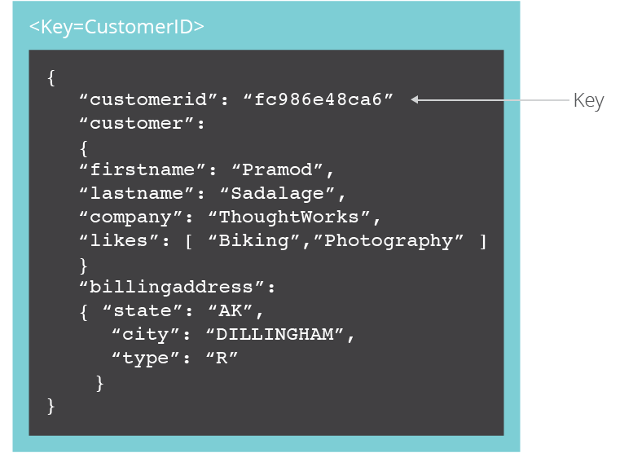
Document Based
The data base store sand retrieves documents. It stores documents in the value part of the key-value store.
Self-describing, hierarchical tree data structures consisting of maps, collections, and scalar values.
Example: LotusNotes, MongoDB, CouchDB, OrientDB, RavenDB.
We use it for content management systems, blogging platforms, we banalytics, real-time analytics,e-commerce applications.
We would avoid it for systems that need complex transactions spanning multiple operations orqueries against varying aggre gate structures

Slide 8
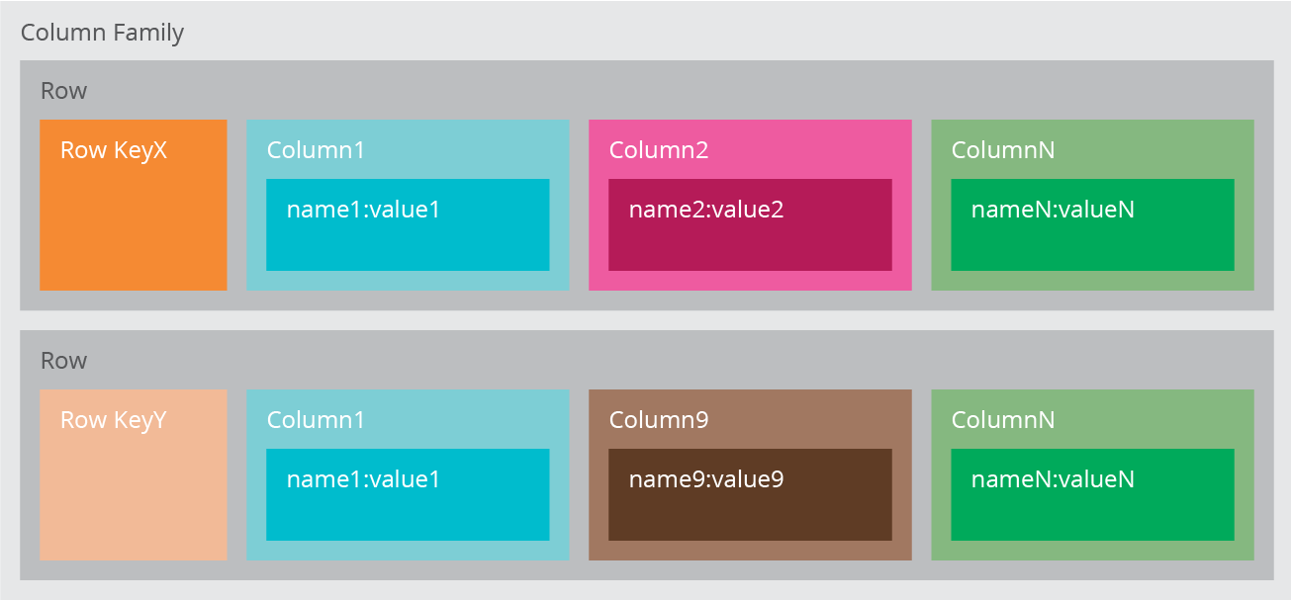
Column based
It store data as Column families containing rows that have many columns associated with arow key. Each row can have different columns.
Column families are groups offre lated data that is accessed together.
Example: Cassandra, HBase, Hypertable, and Amazon DynamoDB.
We use it for content management systems, blogging platforms, log aggregation.
We would avoid it for systems that are inearly development, changing query patterns.
Notes:
Le titre du point principal 2 doit être clair et concis. Chaque argument doit être résumé dans un objectif de clarté et cité correctement. Ne vous contentez pas de lire les différents arguments, mais développez lorsque c’est nécessaire.
[Tapez des notes à développer ici]
Veillez à faire la transition entre le troisième point principal et la diapositive suivante.

Slide 9
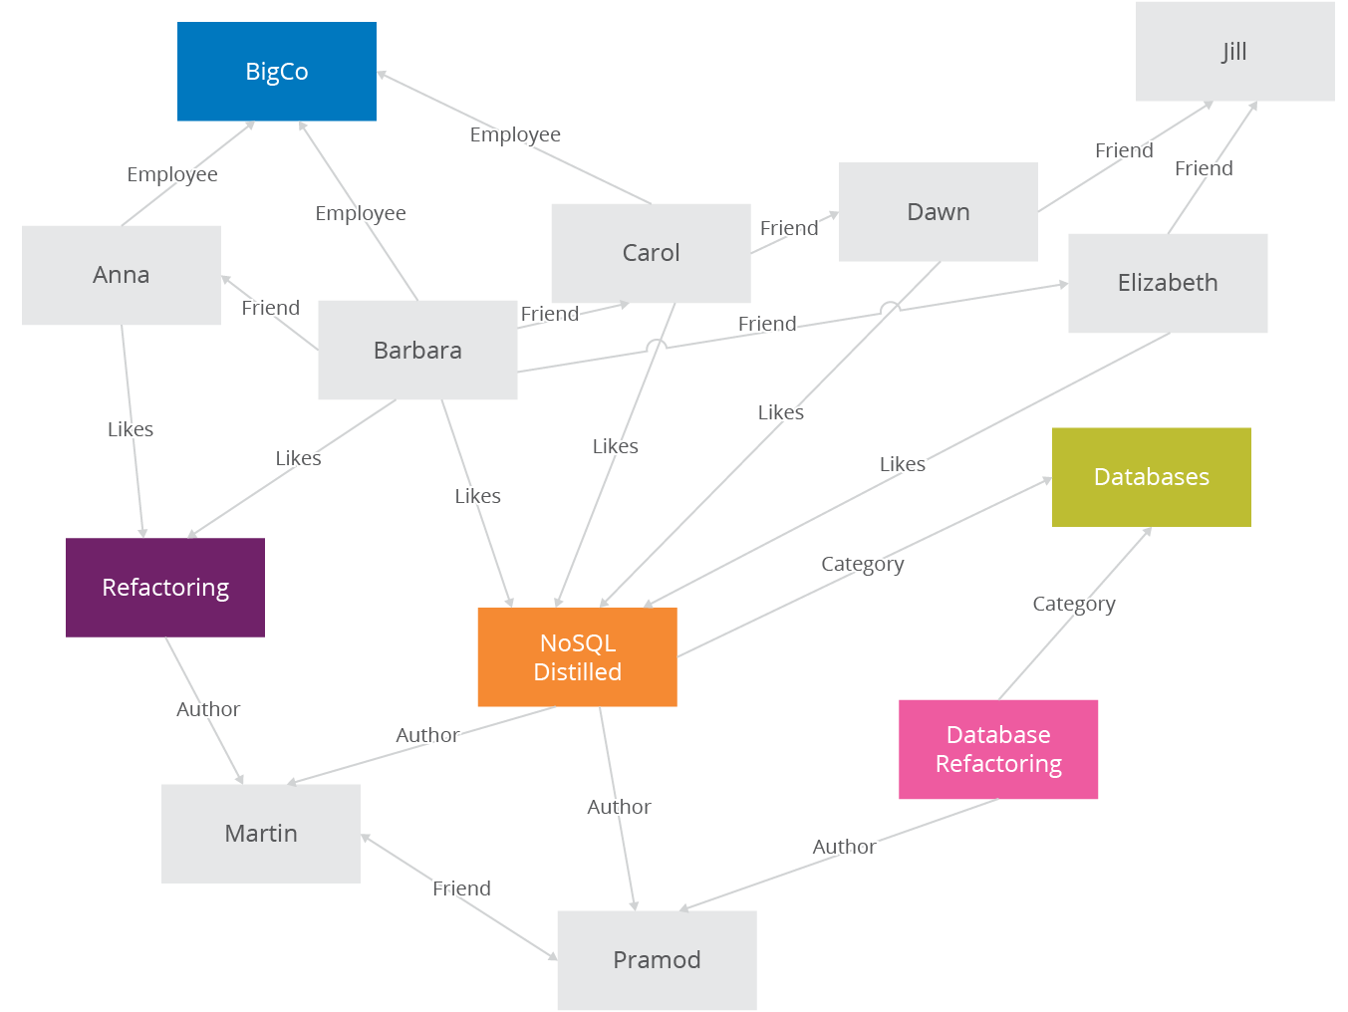
Graph Based
Store entities and relationships between these entities as nodes and edges of agraph respectively. Entitie shave properties.
Traversing the relationships is very fast as relationship between nodes is not calculated at query time but is actually persisted as a relationship.
Example: Neo4J, Infinite Graph, OrientDB, FlockDB.
It is well suited for connected data, such as social net works, spatial data, routing information for goods and supply.

Slide 10
CAP Theorem
According to Eric Brewer a distributed system has 3 properties :
Consistency :different nodes respond with the same data to the same request
Availability: the system responds to a request, even if the system isn’t working or its data is outdated
Partitions: the system detects, remains operational during, and heals a partition caused by the failure of one or many nodes
We can have at most two of these three properties for any shared-data system
To scale out, we have to partition. It leaves a choice between consistency and availability. ( In almost all cases, we would choose availability over consistency)
Everyone who builds big applications builds them on CAP : Google, Yahoo, Facebook, Amazon, eBay, etc.
Notes:
L’argument contraire doit être celui le plus fréquemment mentionné en contradiction de la thèse. L’objectif de cette diapositive est d’évoquer l’argument contraire de façon à renforcer la thèse d’origine. Veillez à évoquer chaque information contradictoire. Dans cette perspective, développez les points inclus sur la diapositive. Veillez à faire la transition vers la diapositive finale, l’étape d’action.

Slide 11
ACID THEOREM
According to Eric Brewer a distributed system has 3 properties :
Atomicity: either all of the operations in a transaction succeed, or none of them do
Consistency:the database enforces rules about its fields and the relationships between fields
Isolation :the extent to which rows that a transaction is affecting can be affected by other transactions
Durability :the database writes its data to a permanent medium (hard drive) so that data is not lost during a power failure or other system failure
The idea of transactions, their semantics and guarantees, evolved with data management itself. As computers became more powerful, they were tasked with managing more data. Eventually, multiple users shared data on a machine. This led to problems where data could be changed or overwritten while other users were in the middle of a calculation. Something needed to be done; so the academics were called in.

Slide 12
Advantages of NoSQL
Cheap and easy to implement (open source)
Data are replicated to multiple nodes (therefore identical and fault-tolerant) and can be partitioned
When data is written, the latest version is on at least one node and then replicated to other nodes
No single point of failure
Easy to distribute
Don't require a schema
Notes:
L’étape d’action désigne ce que le public est censé faire ou penser de la thèse. Elle doit être résumée par une phrase clairement rédigée et pensée. Vous pouvez aussi reformuler l’énoncé de la thèse comme une action. L’objectif de cette diapositive est de communiquer au public un message clair quant à ce qu’il doit faire ou penser à la fin du discours. Il peut être judicieux de terminer par une citation ou une image évocatrice.

Slide 13
What is not provided by NoSQL
Joins
Group by
ACID transactions
SQL
Integration with applications that are based on SQL

